Slide 1
Wadsworth Atheneum Museum of Art Virtual Field Trip
Designed For Elementary-Middle Classrooms
Notes:
Sol LeWitt (American, 1928-2007)
Wall Drawing #1131, Whirls and Twirls (Wadsworth), 2004
Acrylic paint on existing museum walls
The Ella Gallup Sumner and Mary Catlin Sumner Collection Fund, 2004.12.1

Slide 2
Welcome to a virtual school field trip to the Wadsworth Atheneum. As you open each slide, click the microphone icon to hear Lindsey Fyfe, School and Teacher Programs Manager, talk about each artwork.
Be sure to turn on the volume on your computer or device!

Slide 3
My name is Lindsey, and I’ll be your virtual museum tour guide today. It’s nice to meet you!

Slide 4
What is an “atheneum”?
A term popular in the 1800s to describe an institution made for art, history, literature, and the sciences.
A place where people can learn.
The name comes from the Greek Athena, who was the mythological goddess of wisdom.

Slide 5
Daniel Wadsworth: the museum’s founder
Thomas Sully, American (born England), 1783-1872, Daniel Wadsworth, 1807, Oil on canvas, 28 1/8 x 21 7/8 in., Gift of William P. Wadsworth

Slide 6
Notes:
Wadsworth Atheneum, Original Exterior
1842

Slide 9
Sol Lewitt, American, 1928-2007, Wall Drawing #793 C. Irregular Wavy color bands on two facing walls, 1996, Ink on walls, Gift of the Artist with funds for maquette & installation paid for by the Henry D. Miller Fund

Slide 11
Our Art Collection
Over 50,000 works of art in our collection
Artworks span 5,000 years of human history
Started with just 79 objects!
The art belongs to the public. As a public museum, we are its custodians and caretakers.

Slide 12
Jobs in Museums
We have experts on our staff responsible for taking care of the artworks that are fragile.
Lots of people work at a museum such as Curators, Educators (like me!), Finance, Librarians, Maintenance, and someone who gets to buy the gifts at the gift shop!
If you like to look at and learn about art, working at a museum is a great job!

Slide 13
Highlights of our Collection

Slide 14
Pablo Picasso, Spanish, 1881-1973 The Artist, 1963, Oil on canvas, 39 ½ x 28 7/8 in., Gift of the Carey Walker Foundation

Slide 15
Hydria Vase Greek, Athens c. 530-500 BCE, Clay, 18 ½ x 15 ½ in. The Ella Gallup Sumner and Mary Catlin Sumner Collection Fund

Slide 16
Sepulchral Figure of Bactrian Camel Chinese, T’ang Dynasty, 8th Century, Glazed Pottery, 34 ½ X 29 ½ X 13 in., Puchased through the Gift of James Junius Goodwin

Slide 17
The Hudson River School
Albert Bierstadt, American, born Prussia, 1830-1902
In the Mountains, 1866, Oil on canvas, Gift of Junius Morgan in memory of his mother, Juliet Pierpont Morgan

Slide 18
Georgia O’Keeffe, American, 1887-1986 The Lawrence Tree (1929), Oil on canvas, The Ella Gallup Sumner and Mary Catlin Sumner Collection Fund

Slide 19
Alexander Calder, American, 1898-1976, Sumac No. 11, painted metal, The Phillip Goodwin Collection, Gift of James L. Goodwin, Henry Sage Goodwin, and Richmond L. Brown

Slide 20
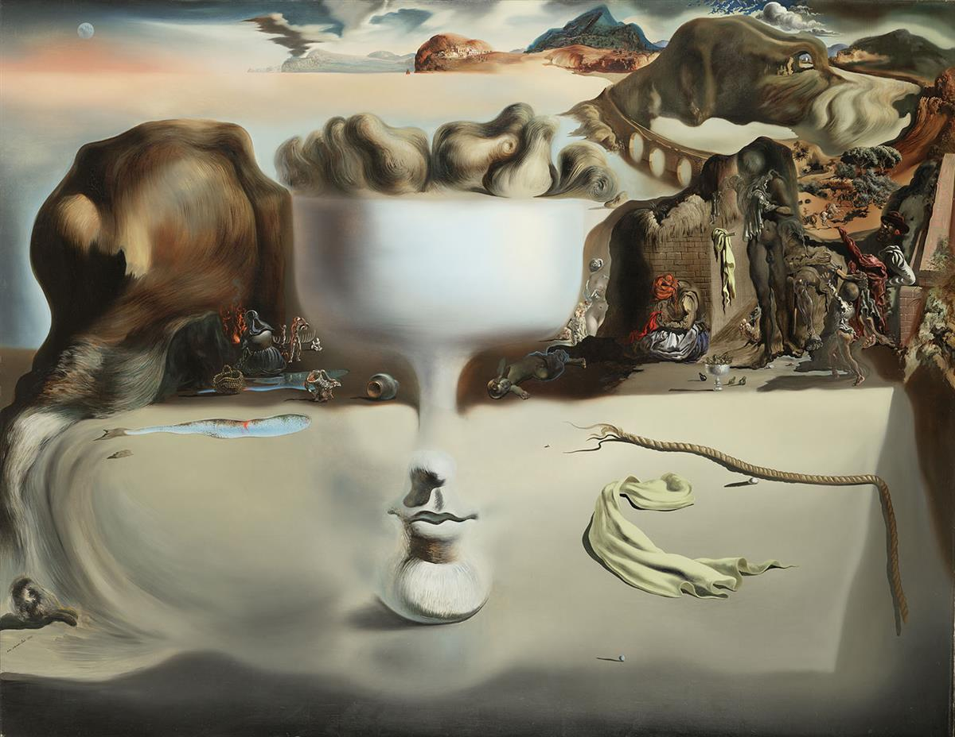
Surrealism
Salvador Dalí, Spanish, 1904–1989, Apparition of Face and Fruit Dish on a Beach, 1938,
Oil on canvas, 45 x 565/8 in., Ella Gallup Sumner and Mary Catlin Sumner Collection Fund

Slide 21
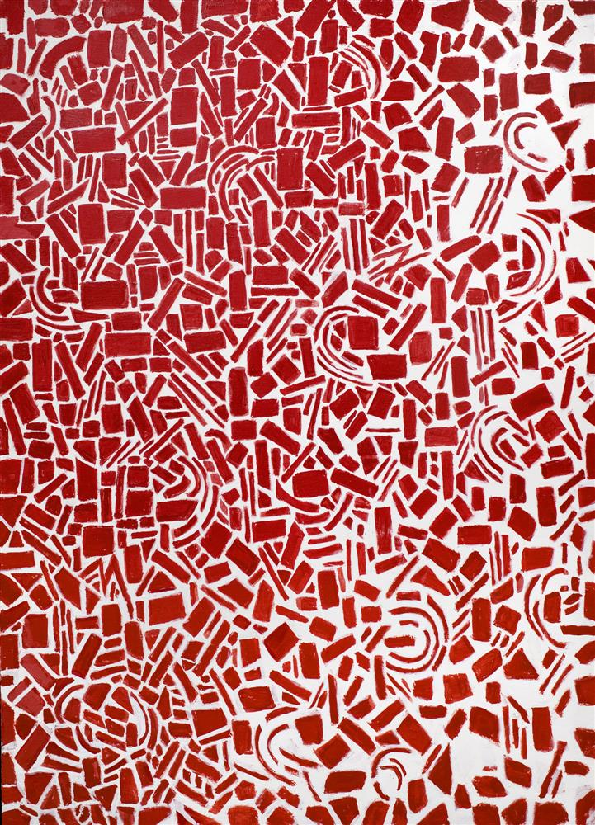
Alma Thomas,
American, 1891-1978,
Red Azaleas Jubilee, 1976,
Acrylic on canvas,
72 x 52 in.,
The Ella Gallup Sumner and Mary Catlin Sumner Collection Fund

Slide 22
Nick Cave, American, born 1959, Soundsuit, 2009, Found, crocheted and hooked rugs, knitted yarn and metal, 96 x 26 x 20 in., African-American Art Purchase Fund

Slide 23
Kehinde Wiley, American, Born 1977
Portrait of Toks Adewetan (The King of Glory), 2016
Oil on canvas
36 x 24 inches
Donated by June Miller Rosenblatt in memory of Bill and Marc Joseph Rosenblatt

Slide 24
Visiting the Museum
Once you are 13 years old, you can visit the museum without a parent or guardian
When you come with your family, your admission is free if you are 17 and under
4-5 PM every day is free admission
Second Saturdays!

Slide 25
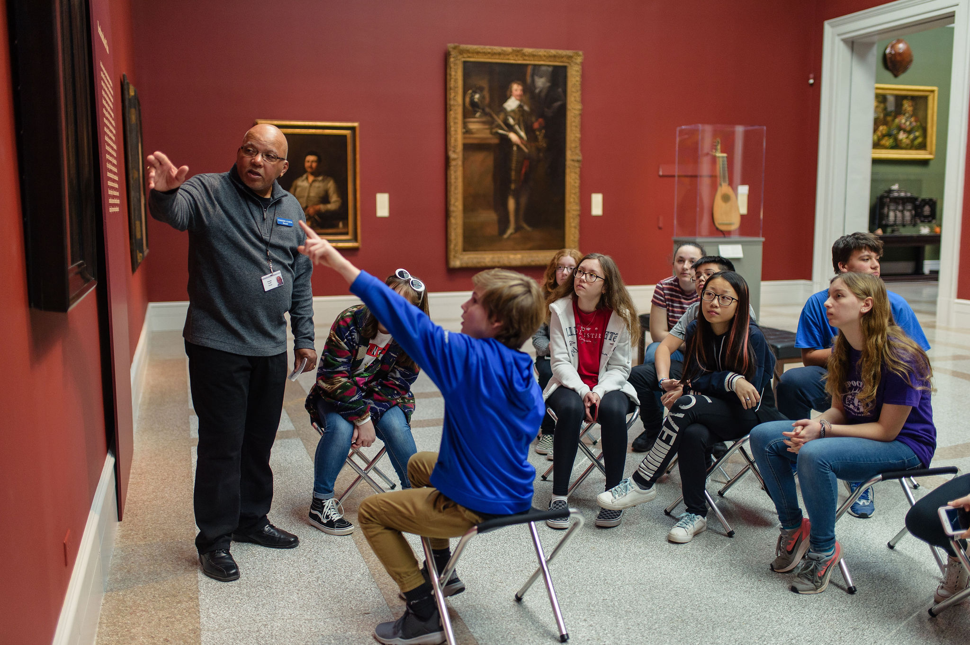

Slide 27
The End

